Slide 1
Building a Leaderboard & Rock, Paper, Scissor Apps SVP 2025
Michael Berrios Kemoy Campbell
Brian Nadworny
08/20/2025

Slide 2
What is a Leaderboard?
List the top players and their stats
Updates the stats
Order who is in first to the last place
Easy to keep track who the top players are among the millions for any game

Slide 3
Rock, Paper, Scissors
The game for this activity is Rock, Paper, Scissors
You will play against the computer
Your wins and losses will be displayed on the Leaderboard

Slide 4
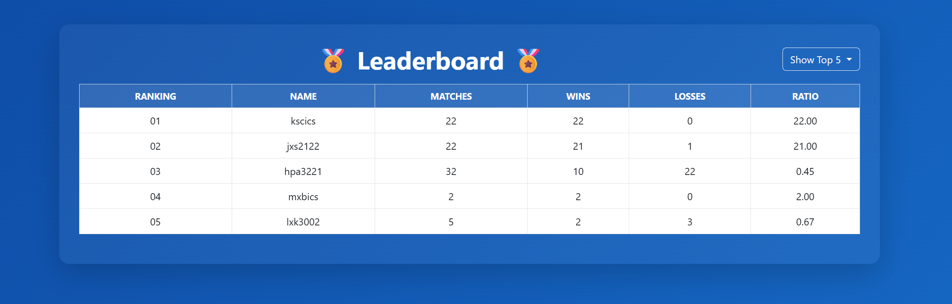
Update # of Tops
Players to Display
Player Names
Win Ratio
Player Position
Total Matches
Wins / Losses

Slide 5
Live Demo – Rock, Paper, Scissors
First, let’s demo a working version of the Leaderboard application
Observe the behaviors of the Leaderboard when the player Wins or Loses a match vs the Computer

Slide 6
DEMO TIME

Slide 7
Technologies to Develop the Web App
Before we dive into the technologies used to develop the web app, what is a web app?

Slide 8

What is a Web App?
Interactive Software accessed through a web browser
Chrome, Edge, Safari, etc.
Runs on a server but responds to user input
Can be accessed anywhere in the world when published, just like Youtube.com or Netflix.com

Slide 9
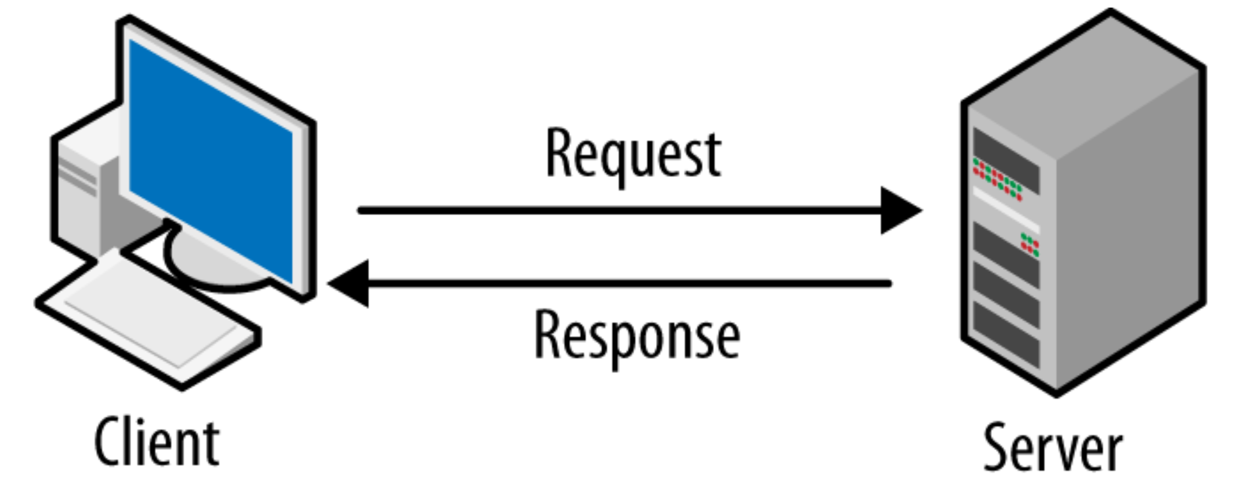
So,… How does a Web App work?
First let’s go over the basics
Client – The browser – needed to access the web app. Users (you) interact with the app
Server – The backend – takes care of handling requests/responses made by the client
Communication happens over HTTP (Hyper-Text Transfer Protocol)

Slide 10



Building the App
Front-End – What the user sees and interacts with
Design, Colors, Buttons and Functions
Technologies Needed –
HTML (Hyper-Text Markup Language – for layout)
CSS (Cascading Style Sheet – for styling and design)
JavaScript (Programming Language for web browsers)

Slide 11



Building the App Cont.
Back-End – Where user send requests
Server – Apache (Responsible for hosting and serving a web application over the internet)
PHP (Programming Language for the backend to handle requests)
MariaDB (Database to store application data)

Slide 12

Building the App Cont.
Code Editor
Before we can code, we need a code editor
Visual Studio Code to the Rescue!!! Free and Powerful

Slide 13
That is a lot for a Web App
Need a Server
Need to Code the Front-End and Back-End
Need a Database
Need Users (you ☺)

Slide 14
XAMPP to the RESCUE!
Installing all of that separately is too expensive and unneeded
Use a Server Environment like XAMPP – it’s Free!

Slide 15
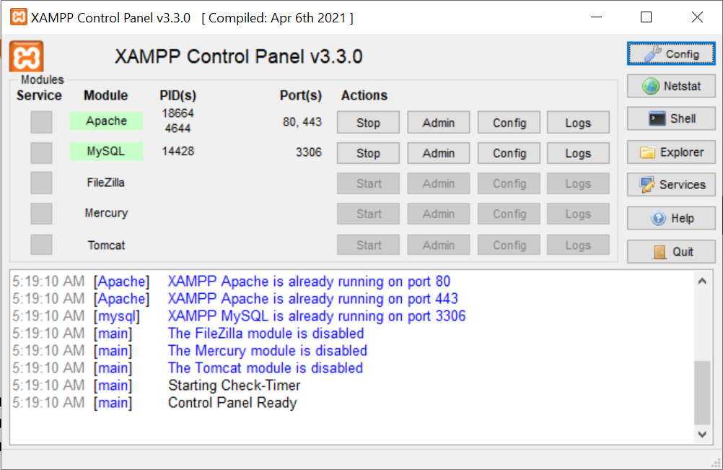
What is XAMPP?
X – Cross Platform (works in Windows, Linux, Mac)
A – Apache (web server)
M – MariaDB (database)
P – PHP (server programming language
P – Perl (scripting language)

Slide 16
So,.. Who’s ready to get started?
We will fix a broken Leaderboard app
You will code for:
fixing styling, and aesthetics of the app
fixing API calls (requests to the server)
We will fix a broken Rock, Paper, Scissors Python App
fixing API calls (requests to the server)
fixing missing/broken functions

Slide 17
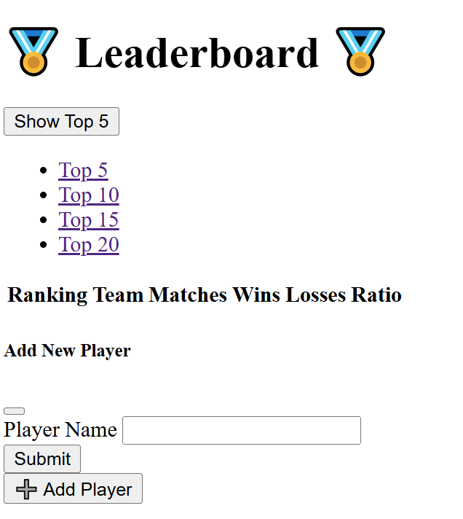

Let’s Fix the Styling!
The Styling is Ewwww right now… it’s broken ☹

Slide 18
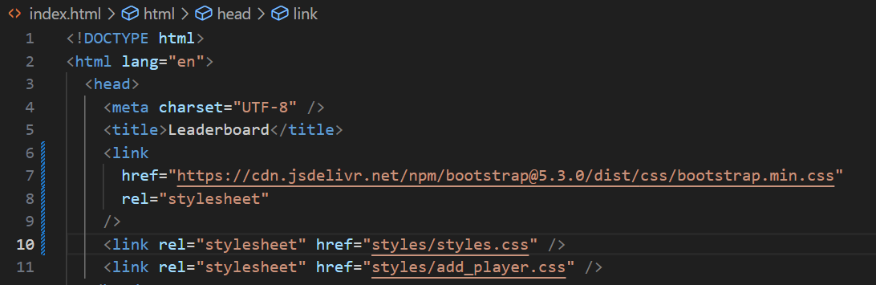
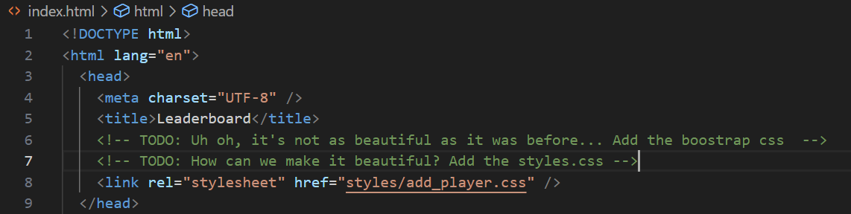
Fix Styling of “index.html” in the Web folder
Import Boostrap CSS
Import Styles.css file

Slide 19
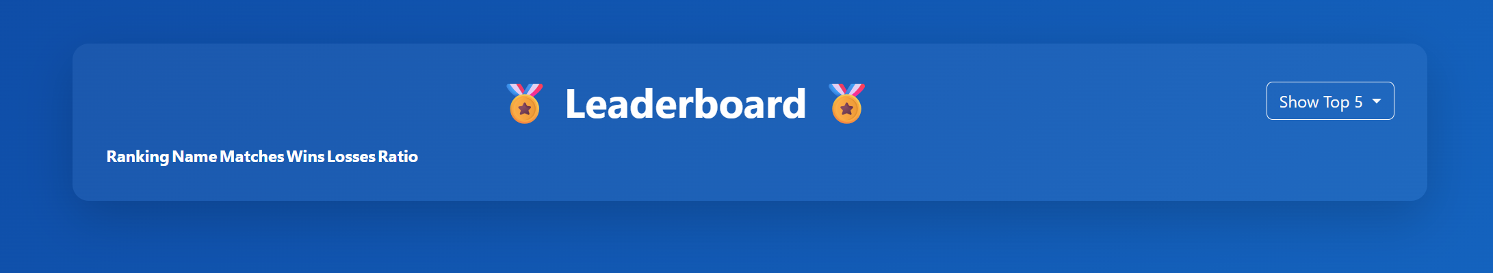

Much Better

Slide 20
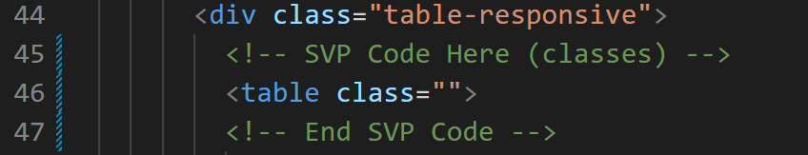
Fix the Columns on the Leaderboard
Add styling Classes to the table tag <table>

Slide 21
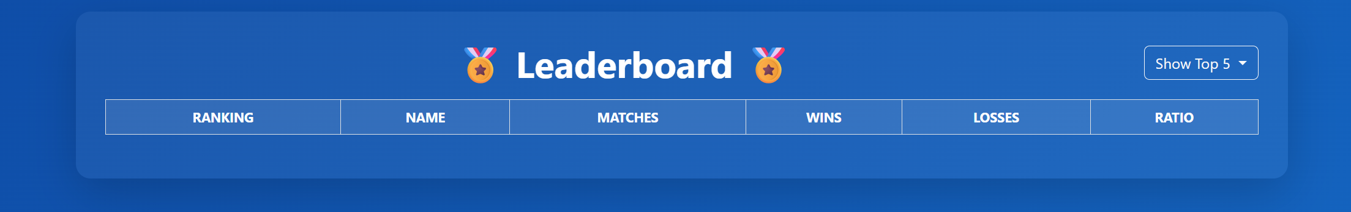
Now Even Better!

Slide 22
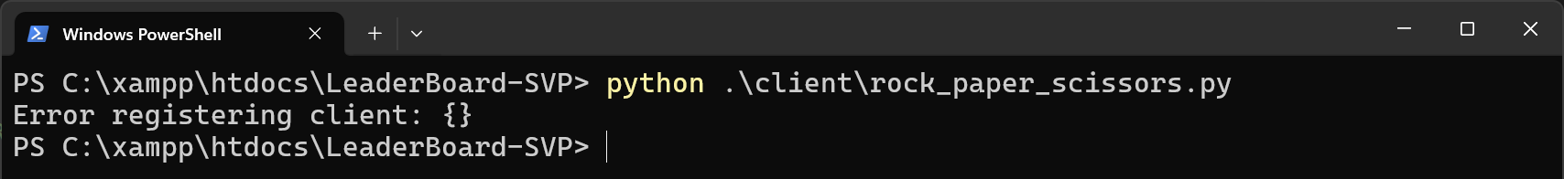
Fix Python App in the Client folder
Prompt (ask) the user to enter their username to login
It’s currently broken

Slide 23
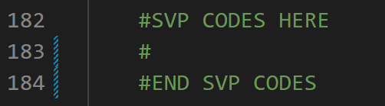
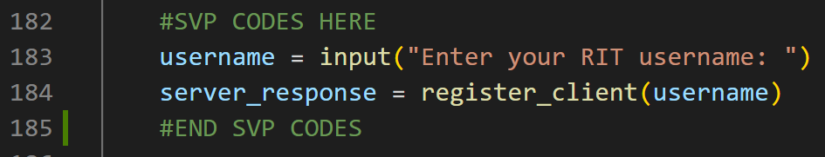
Add the Prompts

Slide 24
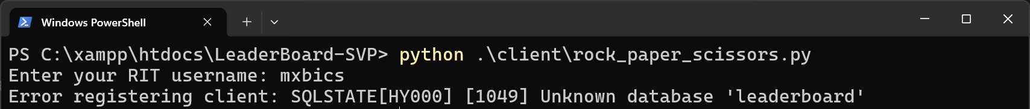
Much Better! Oh uh… we have no Database

Slide 25
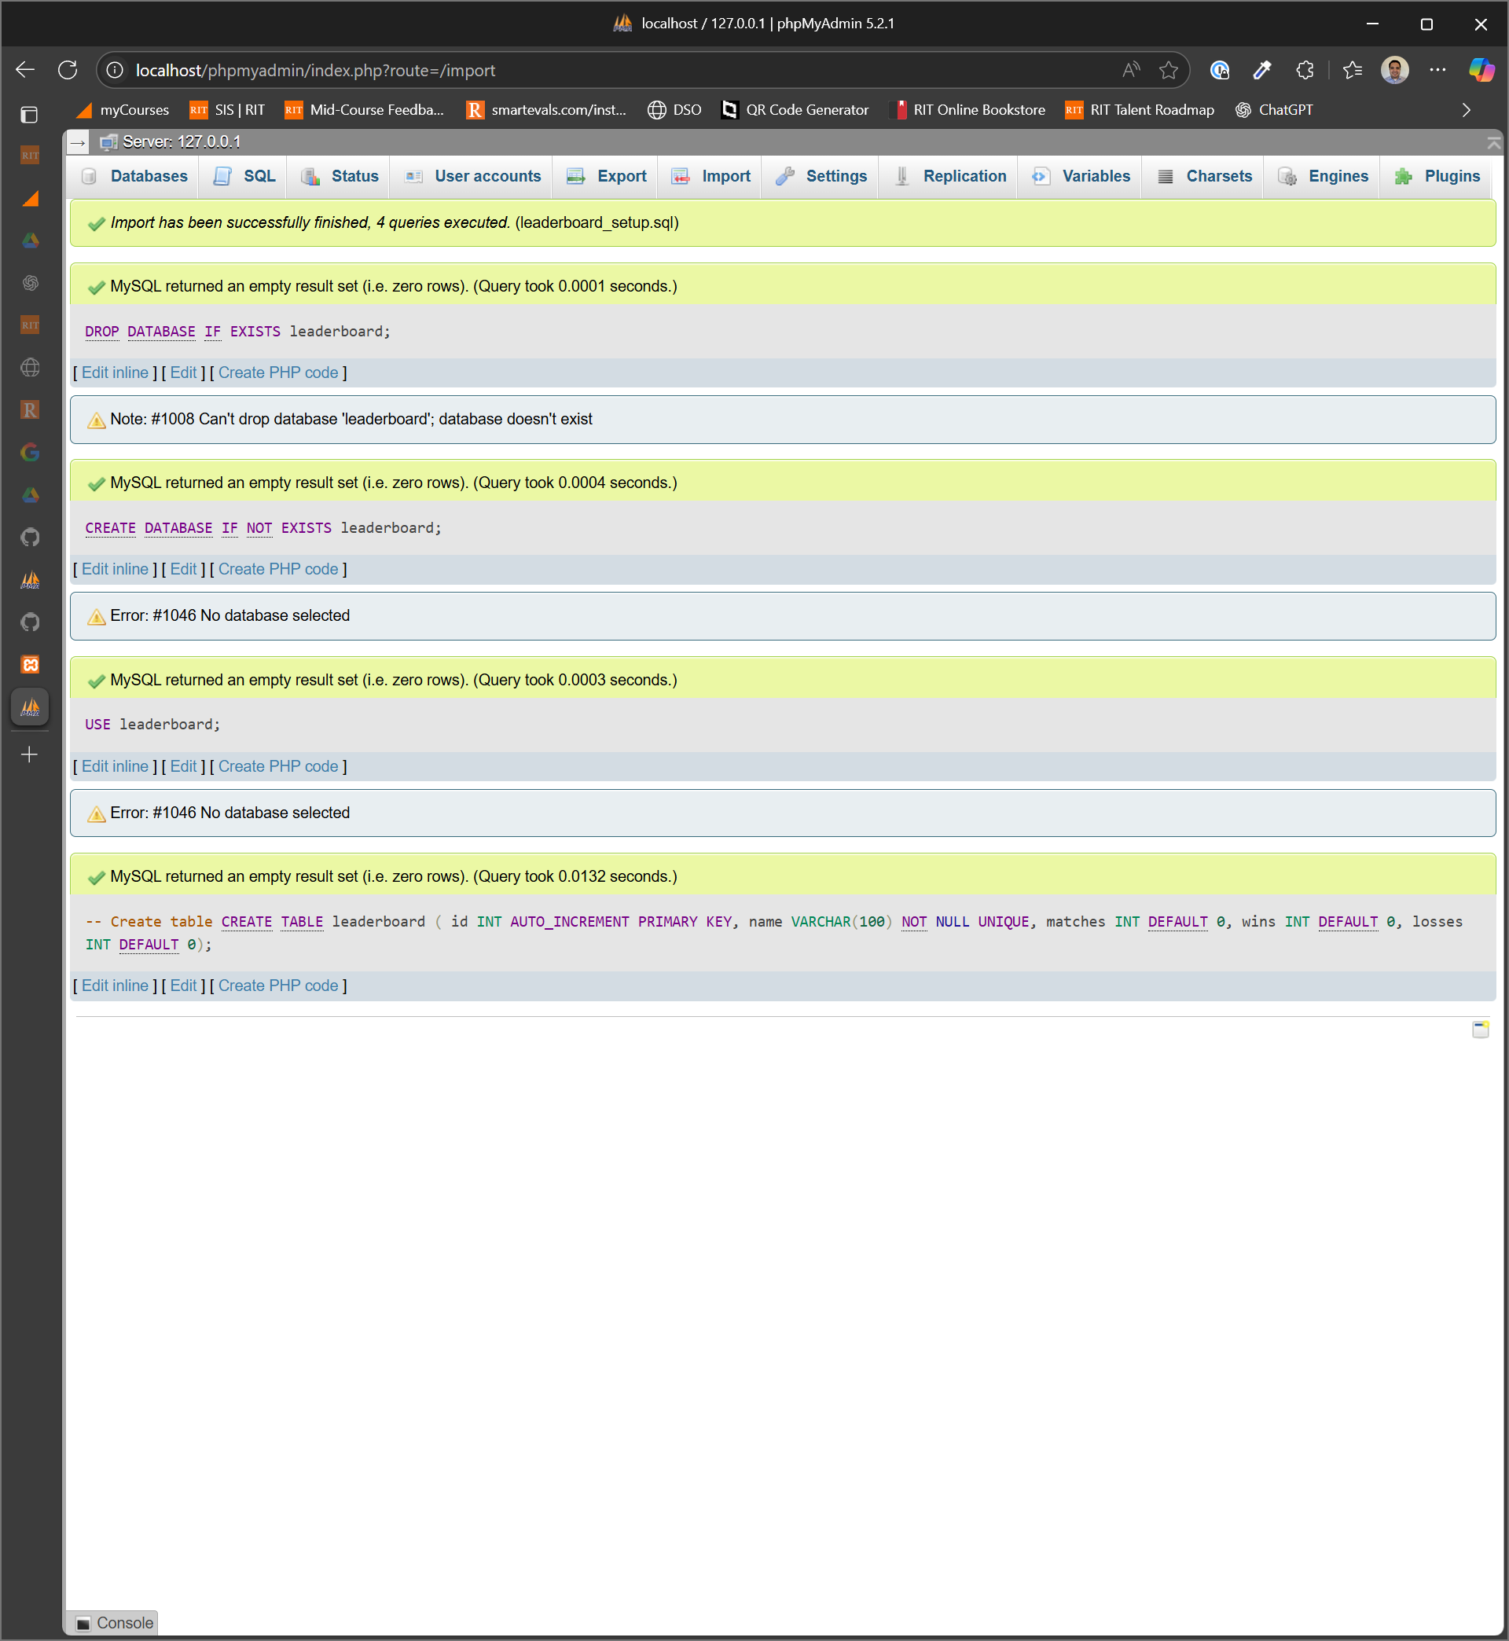
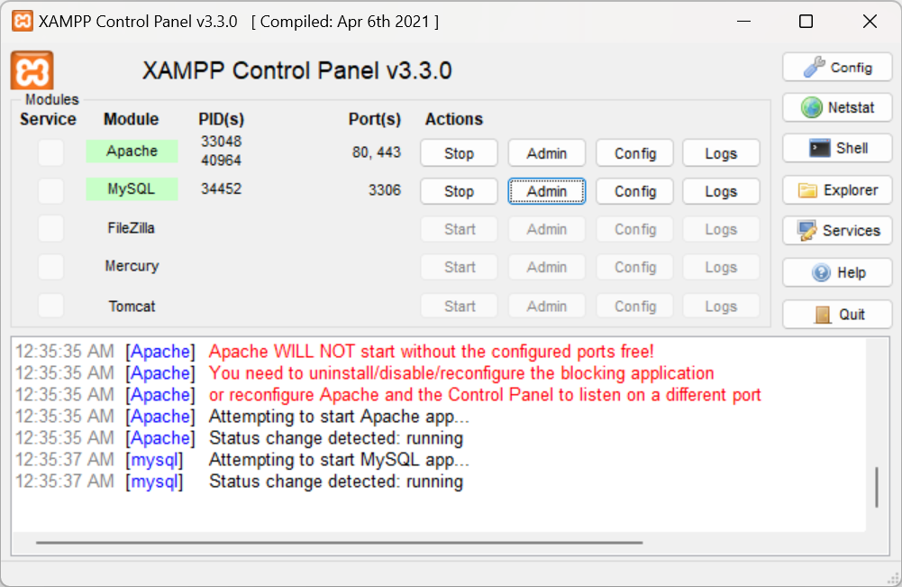
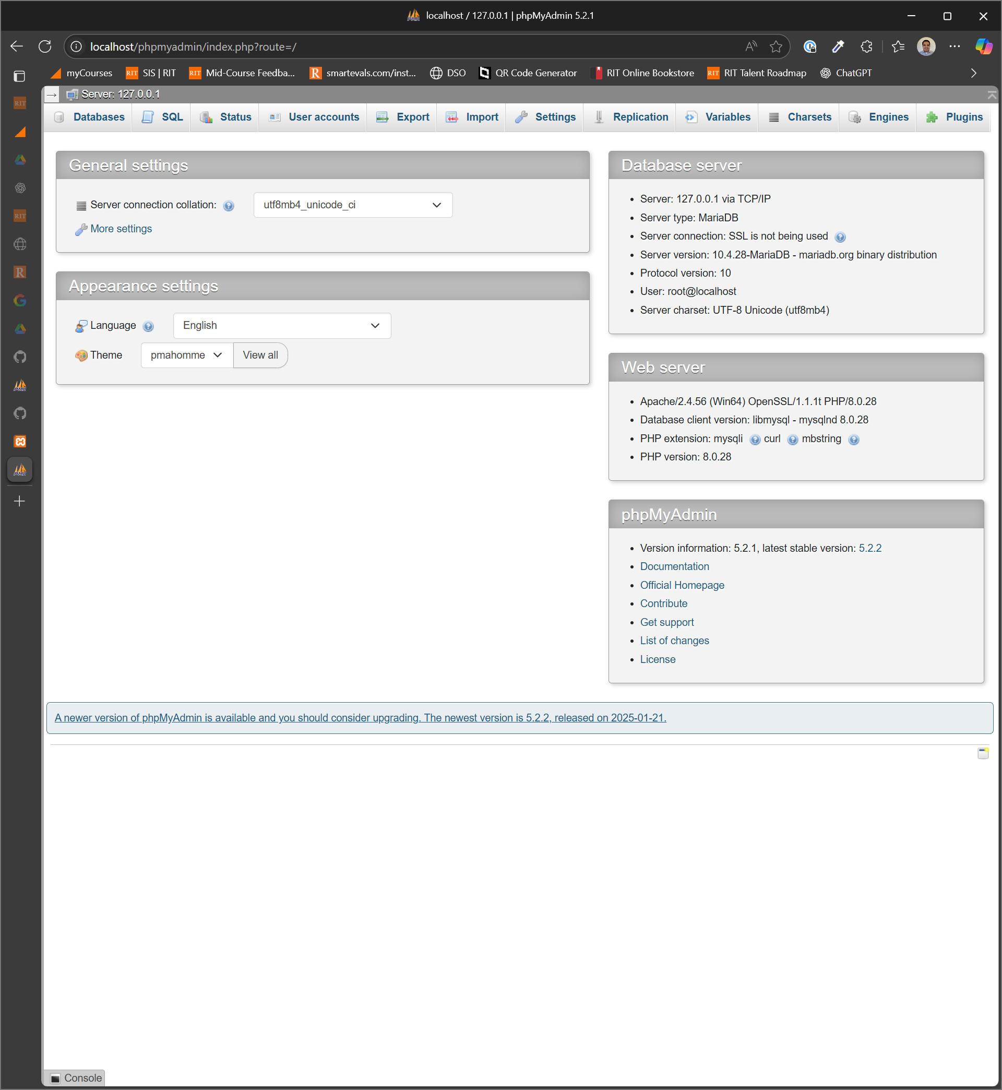
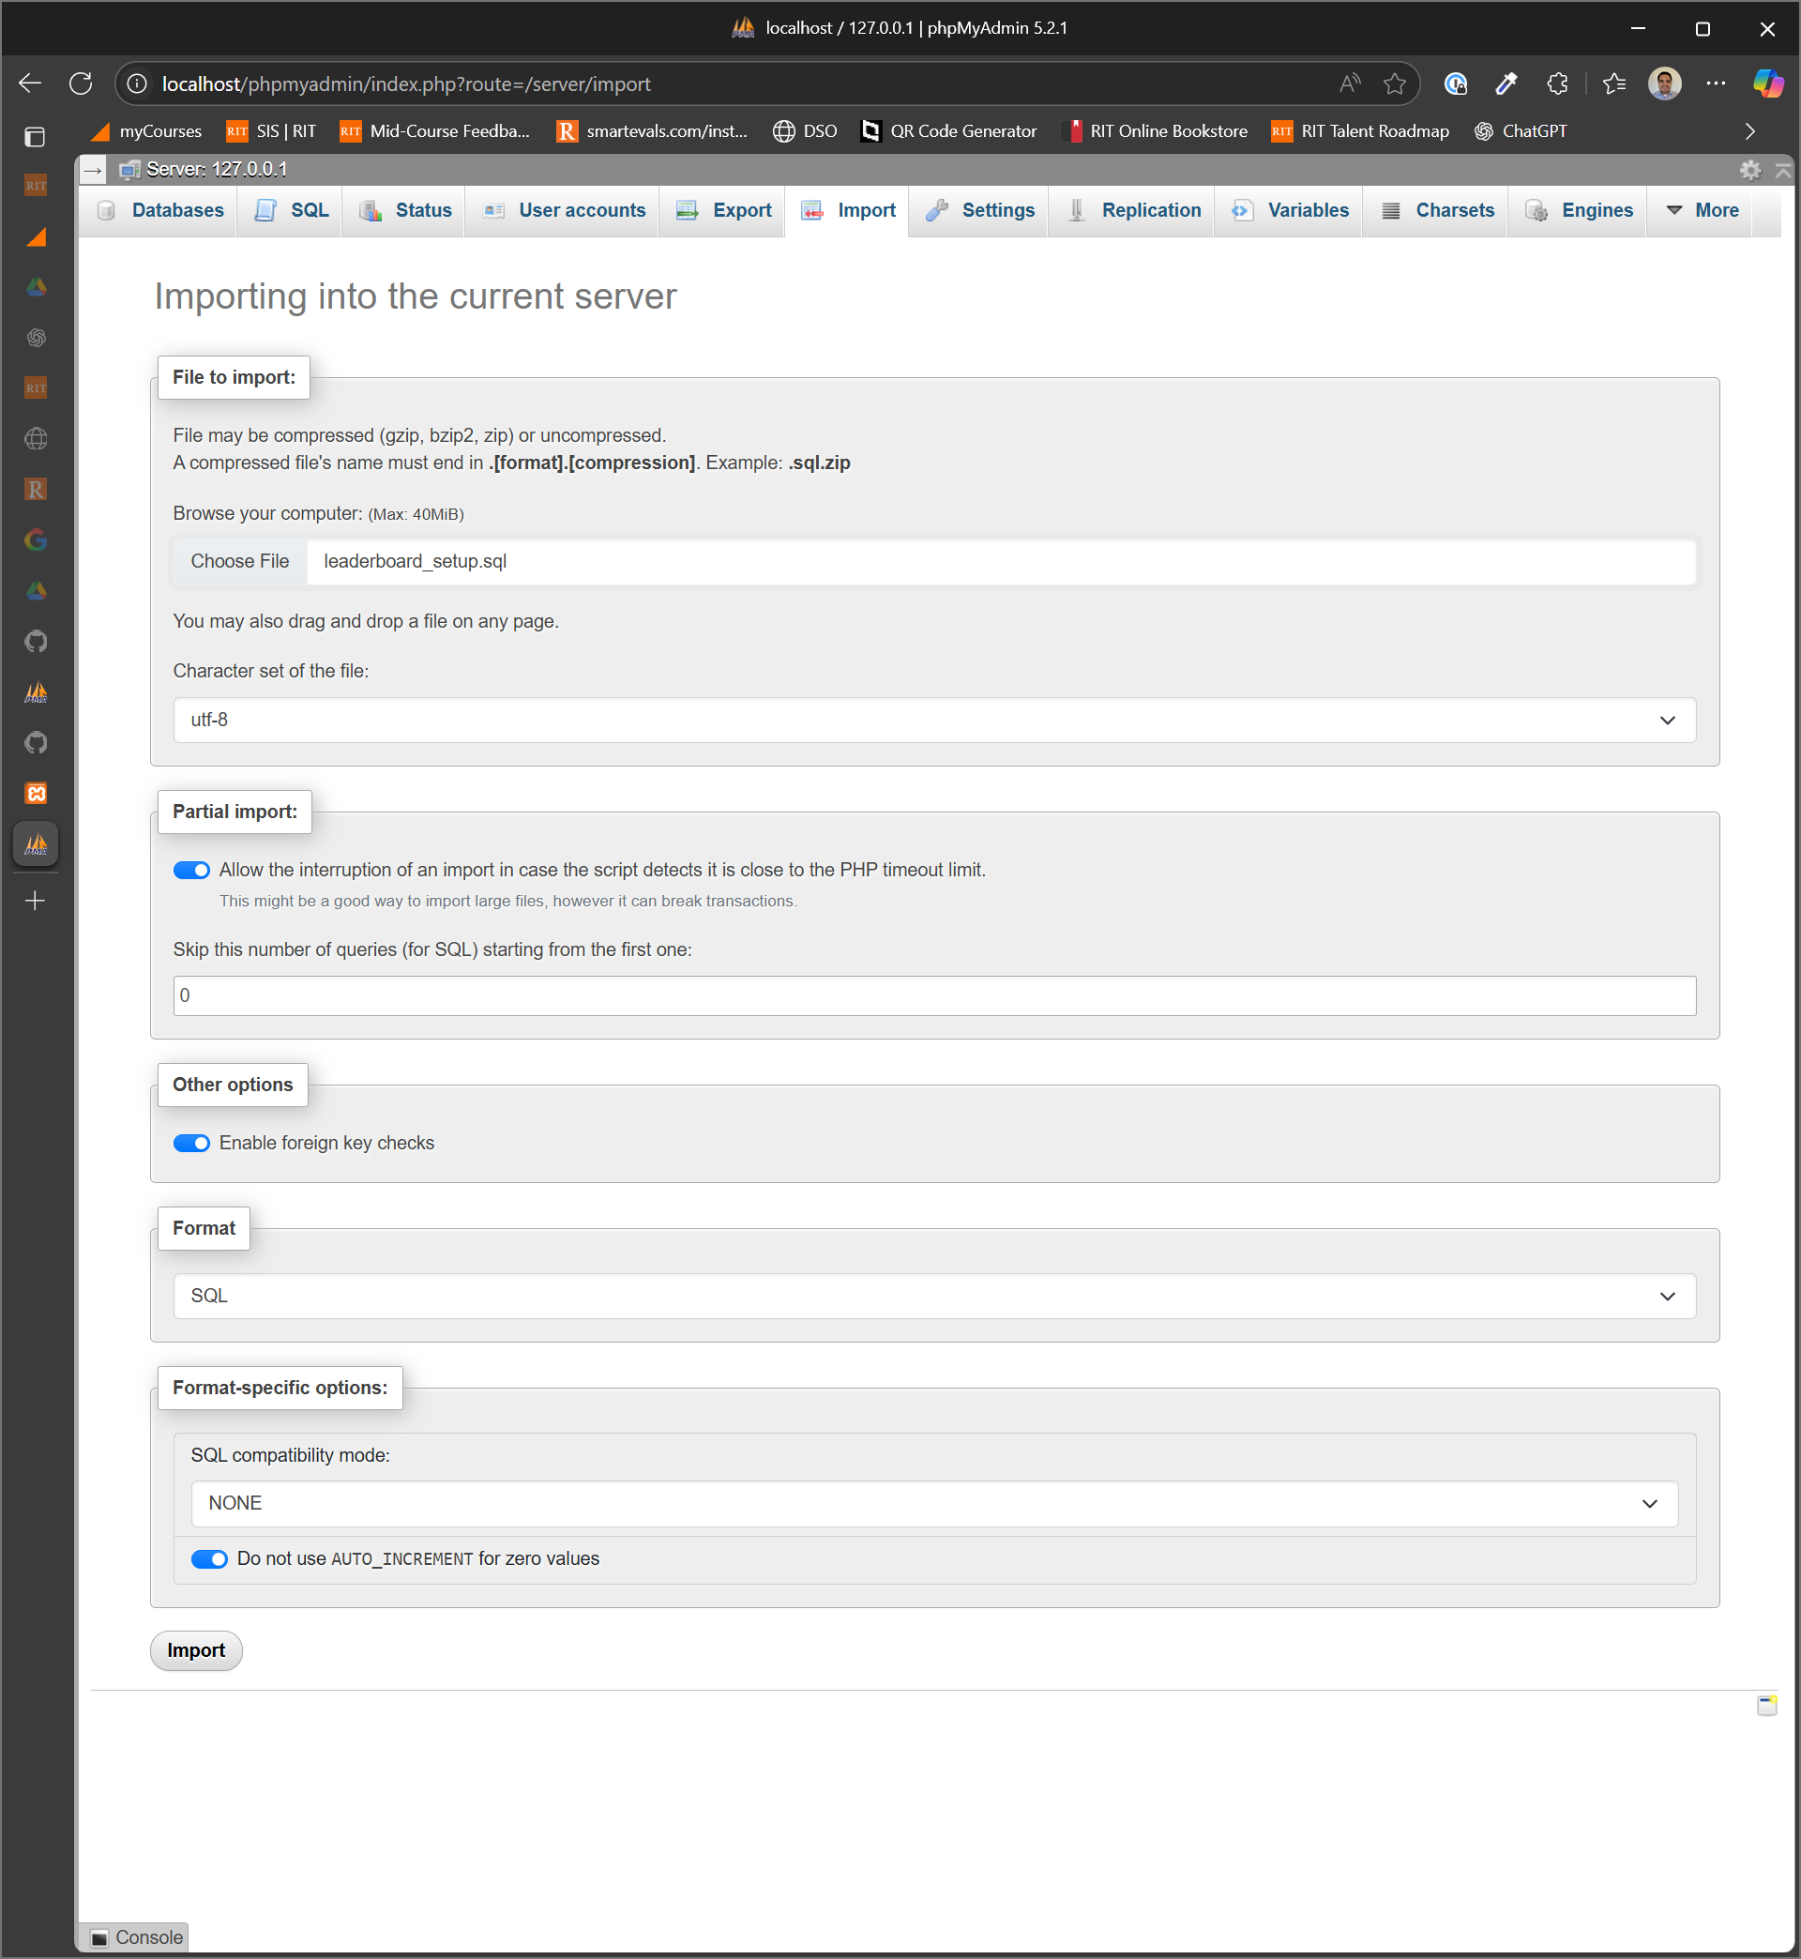
Let’s Migrate the Database
“leaderboard_setup.sql” is in
the web/database folder
Click on the “Import” button at the bottom
after adding the file

Slide 26
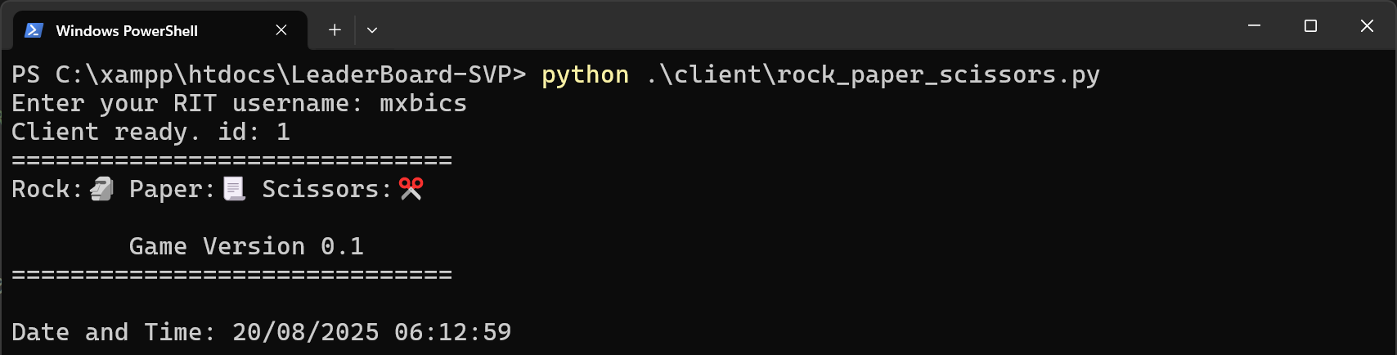
Yes! Database is working!

Slide 27
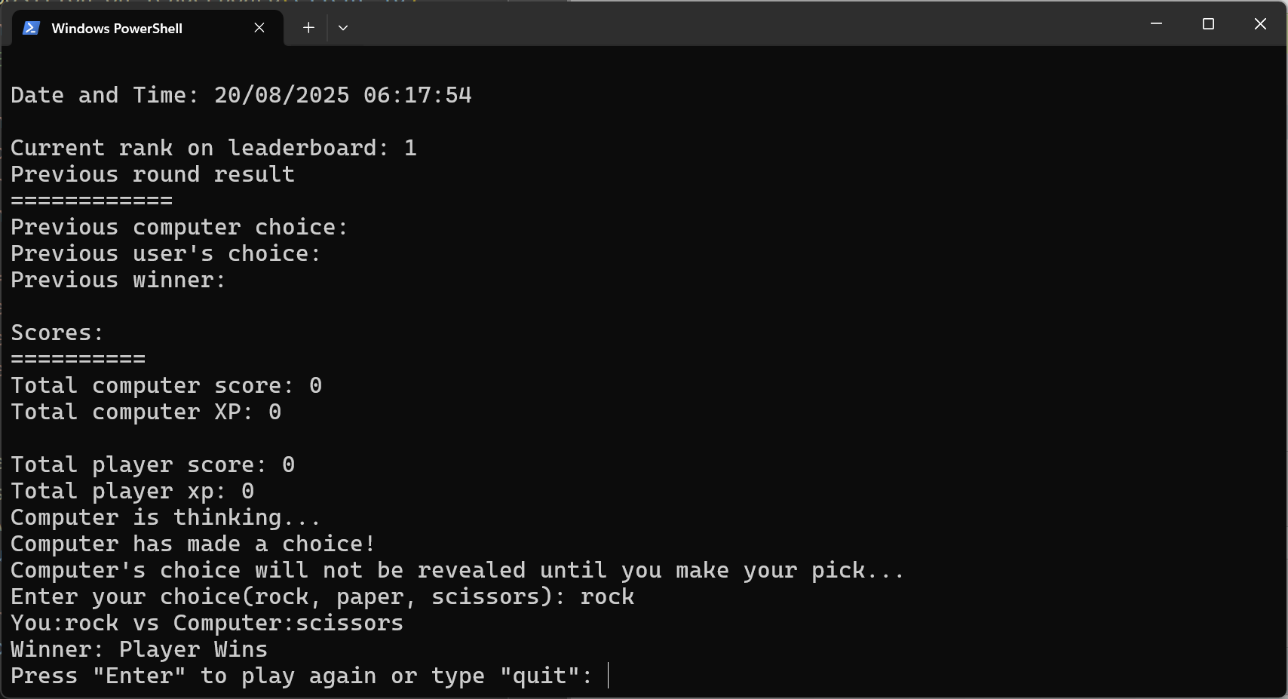
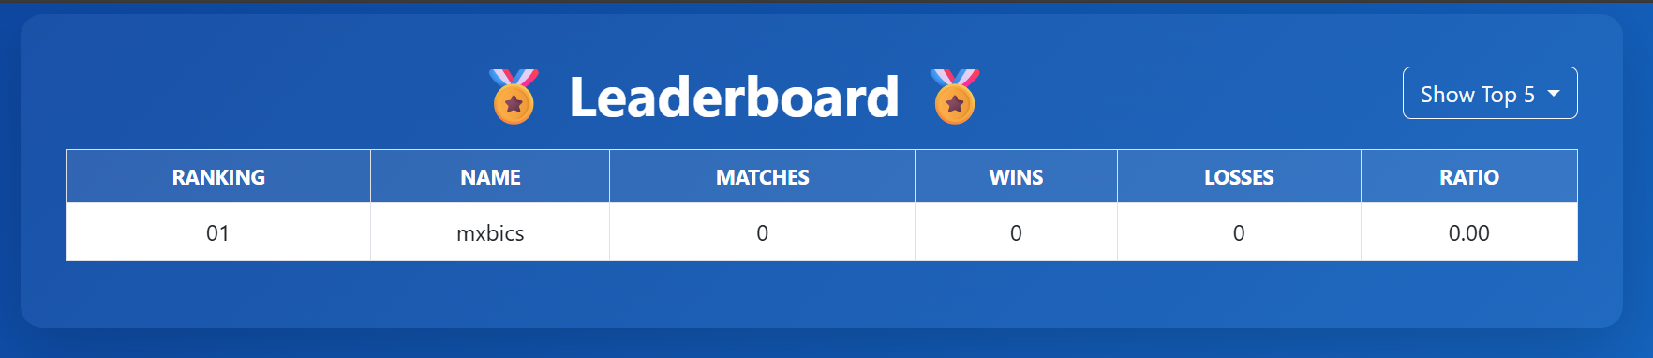
Round won! But Leaderboard didn’t Update

Slide 28
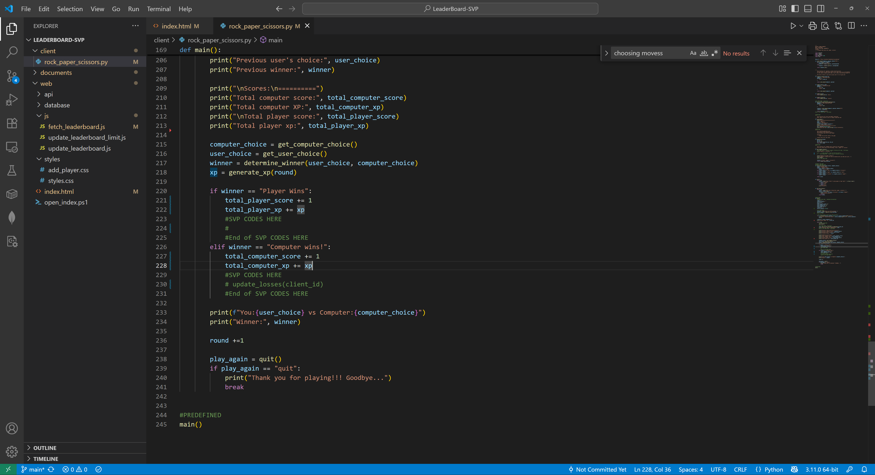
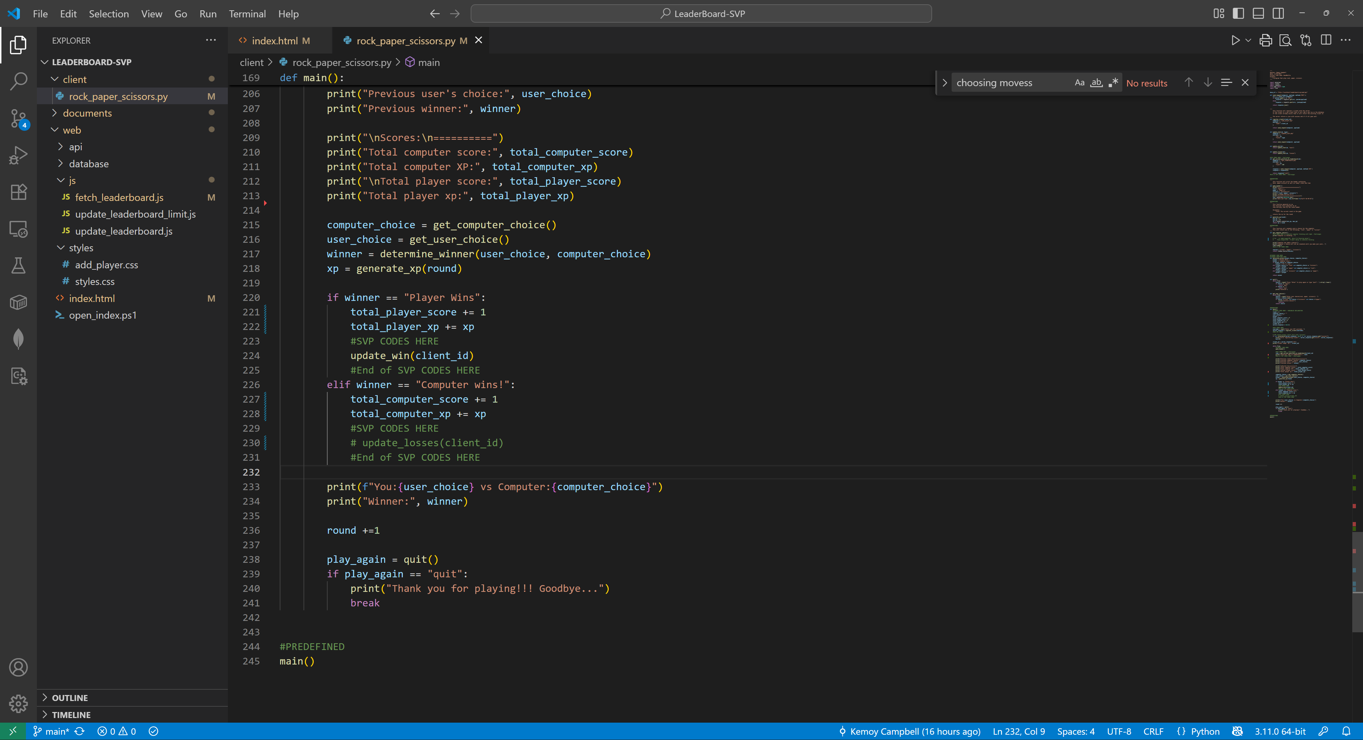

Round won! Fix Leaderboard didn’t Update

Slide 29
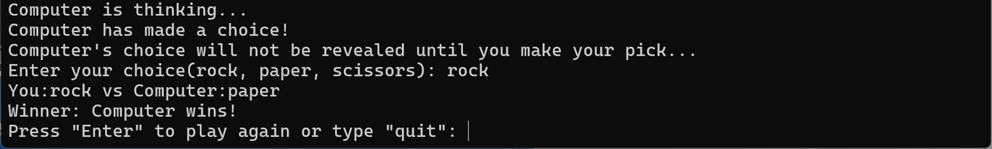
Round lost! But Leaderboard didn’t Update

Slide 30

Can you Fix it?
This Photo by Unknown Author is licensed under CC BY

Slide 31

Ufff… that was a lot of work
There you have it, a fully working Leaderboard Web App
Rock, Paper, Scissors
Congratulations!!!

Slide 32

But wait… there’s more!
You created an app that works only on your machine
Other players from other machines will not show up on your Leaderboard
Let’s modify your code to join the Teacher’s Leaderboard and compete!

Slide 33
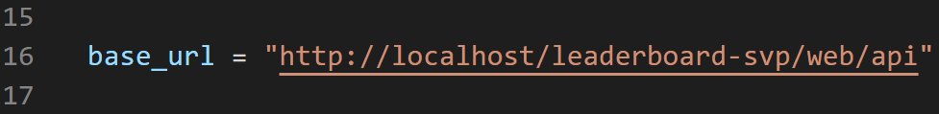
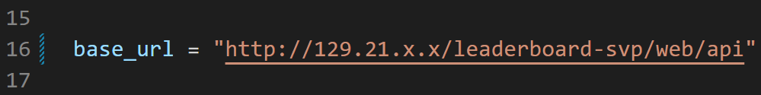
Let’s Modify the API URI in the Client App
In the Python app client/rock_paper_scissors.py – replace the base_url
Replace ‘x’ with teacher provided IP Address

Slide 34
Let’s Play!!!
Run the python client app on your machine and enter your username
Use appropriate username, okay?
Have fun and try to Win!

Slide 35
What you Learned
Application / Software Development
Client / Server Interaction
Code –
Web Front-End (Leaderboard App)
API Back-End (Call handler to update database)
Game Client (Python App)
Database – Stores and Manipulate Data
Development Environment (XAMPP)
Code Editor (Visual Studio Code)

Slide 36
Questions? – Ask Away!

Slide 37
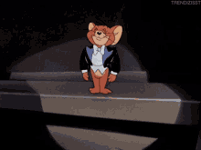
Thank You!

